Slide 1
Section 1.1 Introduction to Function Notations
© Copyright all rights reserved to Homework depot: www.BCMath.ca

Slide 2
I) What is a Function Notation?
is a symbol for representing a function and it replaces the ‘y-variable in an equation
‘f’ is a function of ‘x’
You can use other letters to represent a function→ g, h, t,
Rule: Whatever ‘x’ becomes in the brackets (left), you replace that with the same value for ‘x’ on the right side of the equation
Ex: Given the equation for the function, evaluate the following:

Slide 3
Practice: Given the function, evaluate each of the following:

Slide 4
Adding/Subtracting/Multiplying/Dividing Functions
When a constant is placed in front of a function, that constant will be multiplied to each term of the function:
When there are two or more functions adding/subtracting one another, combine like-terms by adding or subtracting them

Slide 5
Practice: Simplify or Evaluate the following

Slide 6
II) How to READ function notations
The value inside the brackets for ‘x’, is the input number (x-coordinate) and
The value of the function is the Output number (y-coordinate)
The function h(x) will
have a point at (4,22)
Ex: Given the graph of y=f(x), which statement is correct:
8
6
The input number is “5”
4
According to the graph F(x), when the x-coordinate
is ‘5’, the y-coordinate is ‘4’
2
The correct statement is
1
2
3
4
5
6
7
8
9

Slide 7
Evaluate the following using the graphs:
Solid Dot; Value
at this point
Solid Dot; Value
at this point
8
8
6
6
Hollow Dot
No value
4
4
2
2
Hollow Dot
No value
0
1
2
3
4
5
6
7
8
9
1
2
3
4
5
6
7
8
9
0

Slide 8
III) Composite Functions: Input Value as a function
When the input value is a function, replace every “x” in the equation with the inserted function, make sure to simplify
Suppose find the following

Slide 9
Practice: Given each function evaluate the following

Slide 10
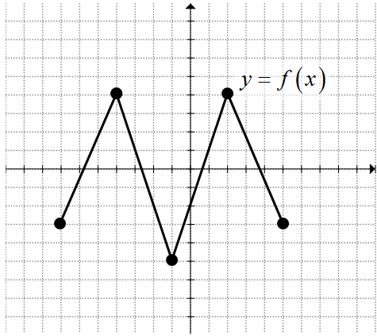
Ex: Given the graph of f(x), evaluate the following

Slide 11
Suppose:
and we are given that:

